Slide 1
Balanced multicategory pilot

Slide 2
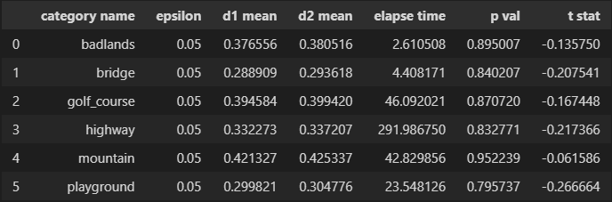
Dataset
6 categories , 10 Images from each category

Slide 3
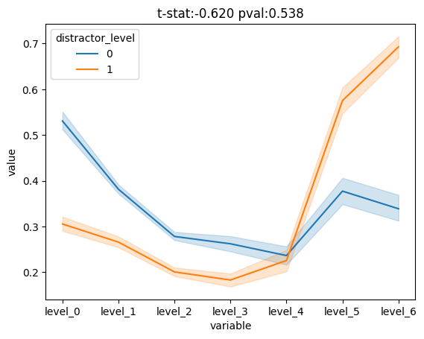
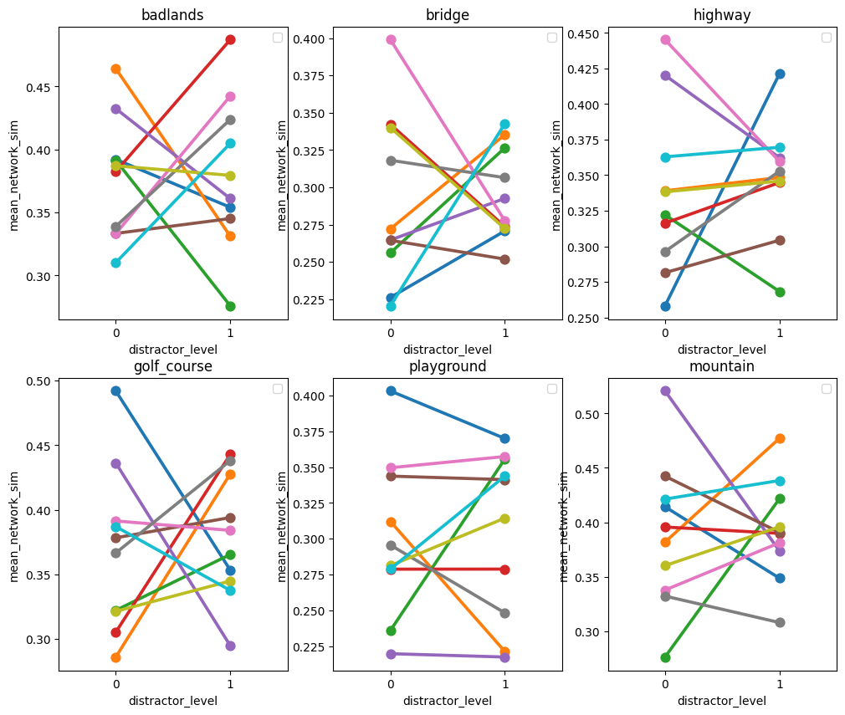

Slide 4
Same day results – participants
90 recruited
80 valid
summary for criterions:
demo accuracy higher than 0.0 - qualified: 80
demo attention check correctness equals 1.0 - qualified: 80
experiment encoding attention check accuracy 0.6 - qualified: 62
experiment longest consequtive strike of maximum of 15.0 responses - qualified: 71
test too fast (thresold: 0.3, allowed count: 5.0 qualified: 72
test too slow (thresold: 10.0, allowed count: 2.0 qualified: 73
demo rating varience higher than 0.0 - qualified: 80
above chance accuracy in test, qualified: 66
OVERALL: number of qualified participants (adhere to all criterions): 42

Slide 5
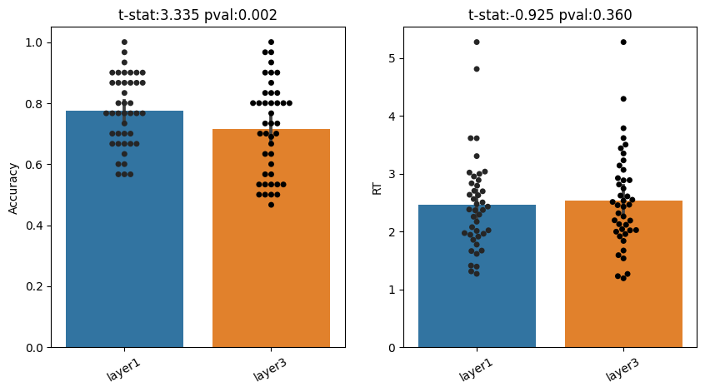
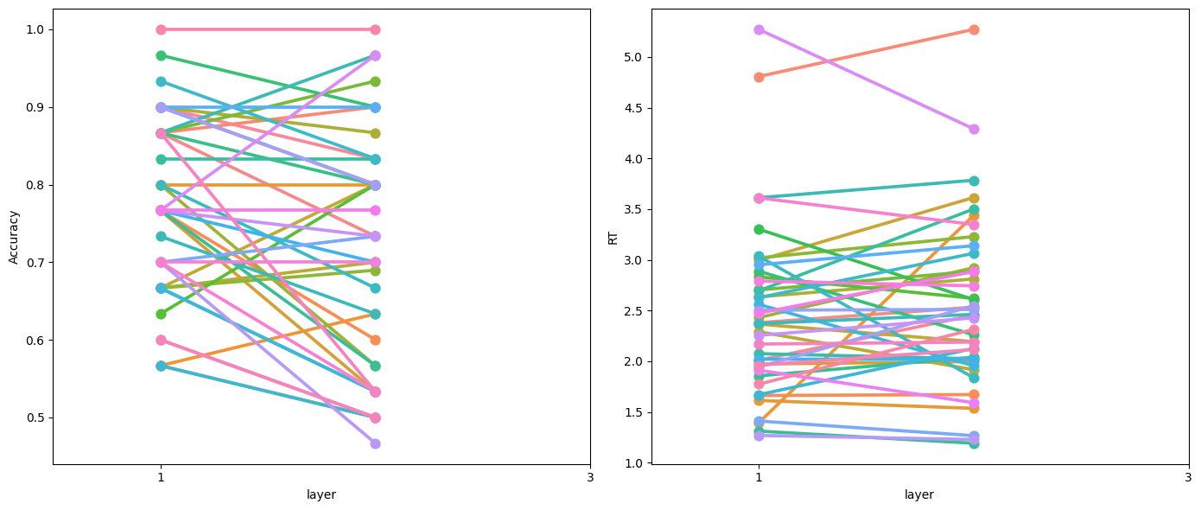
Same day results

